Slide 1

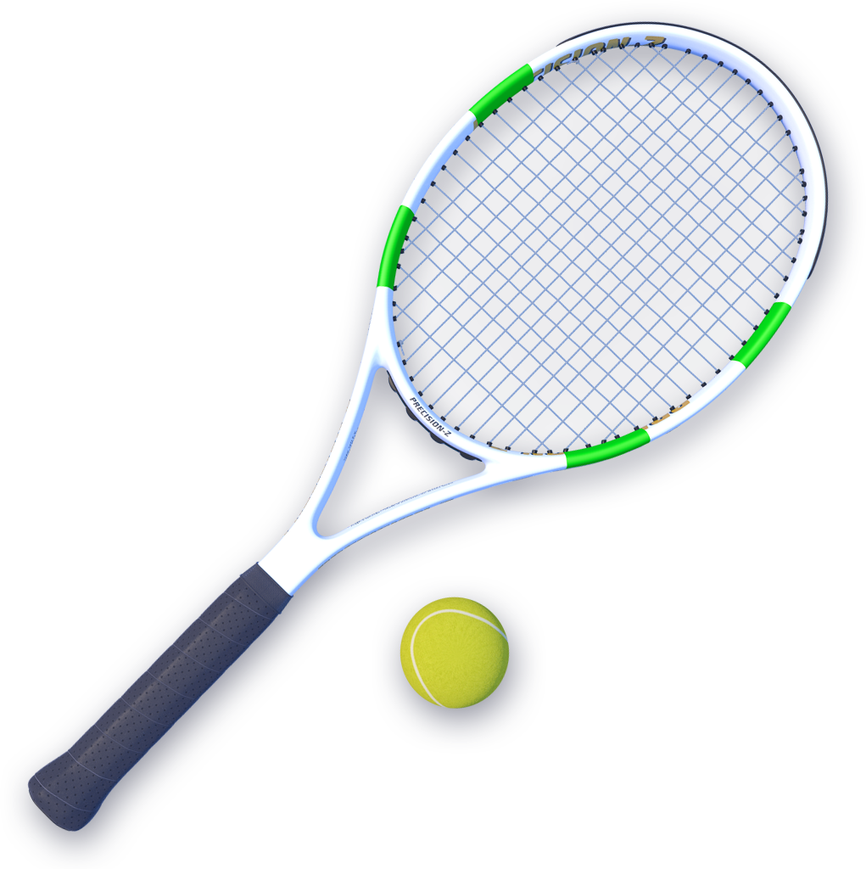
TENNIS
SPORTS ANALYTICS
Angel Fernandes

Slide 2

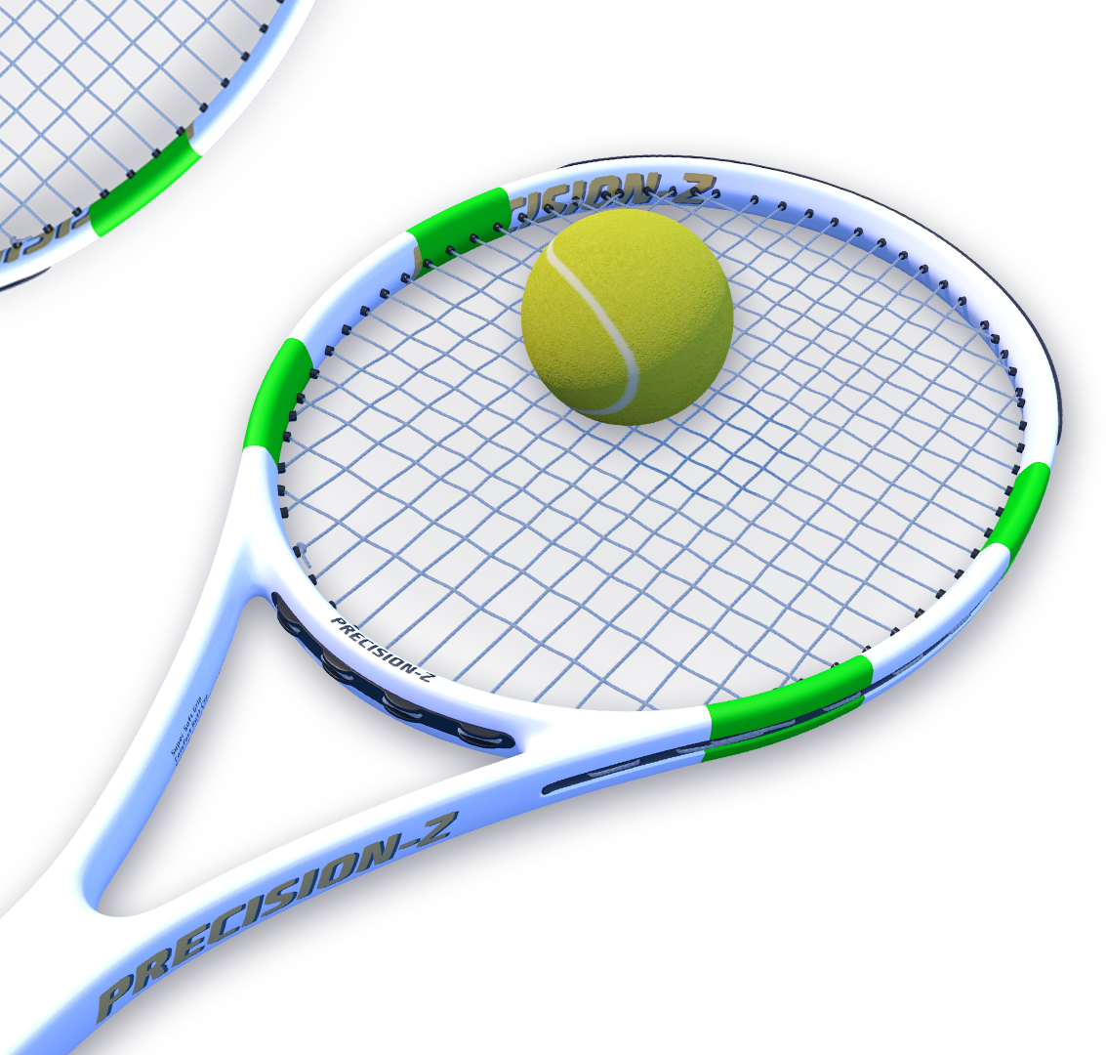
WHY ?
RAFAEL NADAL
MARIA SHARAPOVA
DATA
Github Package: Deuce
Data collected and what they contain:
atp_elo - ATP Elo Ratings
atp_odds - ATP Match Odds
atp_rankings - Rankings of ATP Players
atp_tournaments - ATP Tournaments

Slide 3

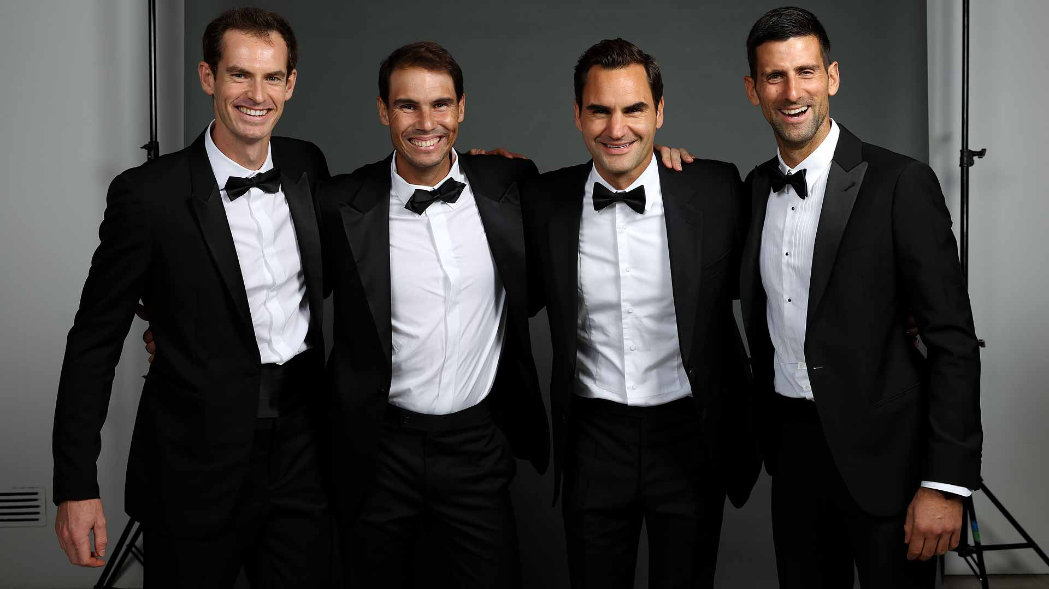
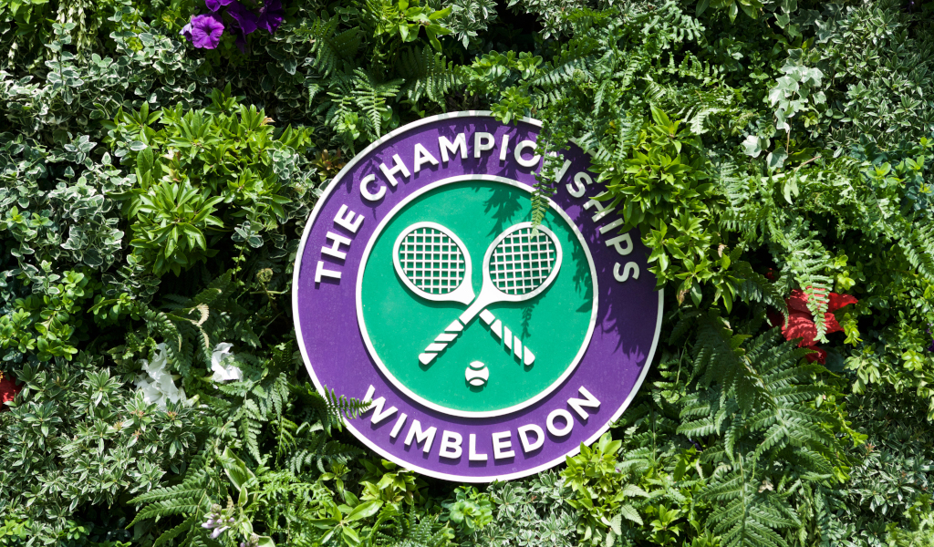
Data Preparation
Tournament : Wimbledon
Start Year: 2000
Players I chose:
Rafael Nadal
Roger Federer
Andy Murray
Jo-Wilfried Tsonga
Novak Djokovic
Important Variables:
ELO ratings (before & after)
Seed / Ranking
Game Statistics
Sets
Games
Points
Love
Deuce
Research Question
Who is the GOAT?
(Right answers only)
Rafael Nadal

Slide 4

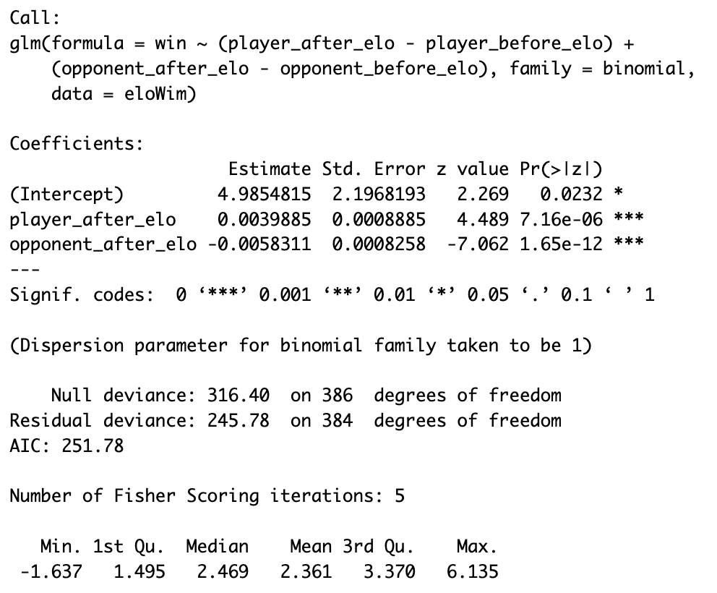
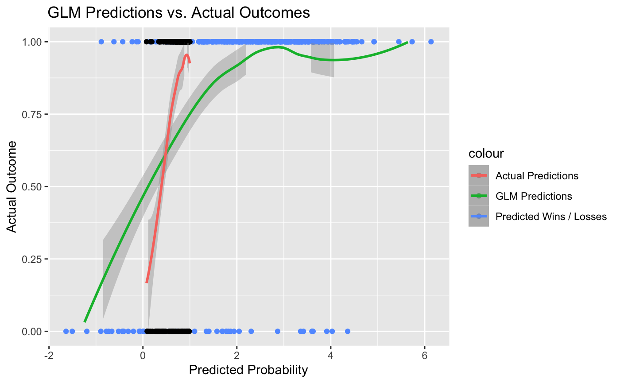
Data Analysis
atp_elo - Winning Predictions
Notes:
atp_elo - ATP Elo Ratings
The predictors are the differences in "player_after_elo" and "player_before_elo" and the differences in "opponent_after_elo" and "opponent_before_elo."
The coefficient estimates are player_diff and opp_diff
The significance of the coefficients is indicated by the p-values. The intercept is significant at the 0.05 level. Both "player_diff" and "opp_diff" are not statistically significant.

Slide 5
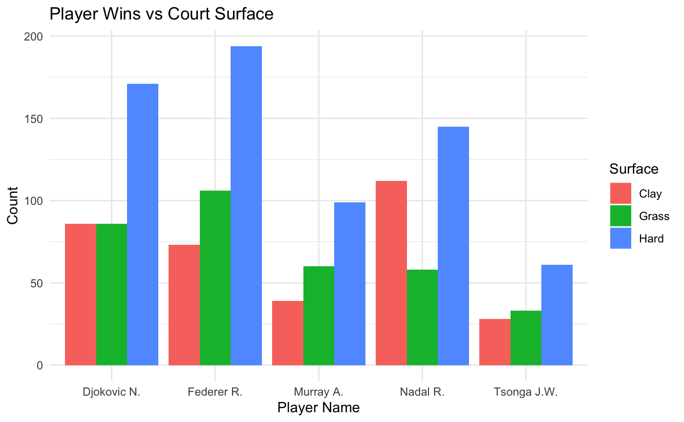
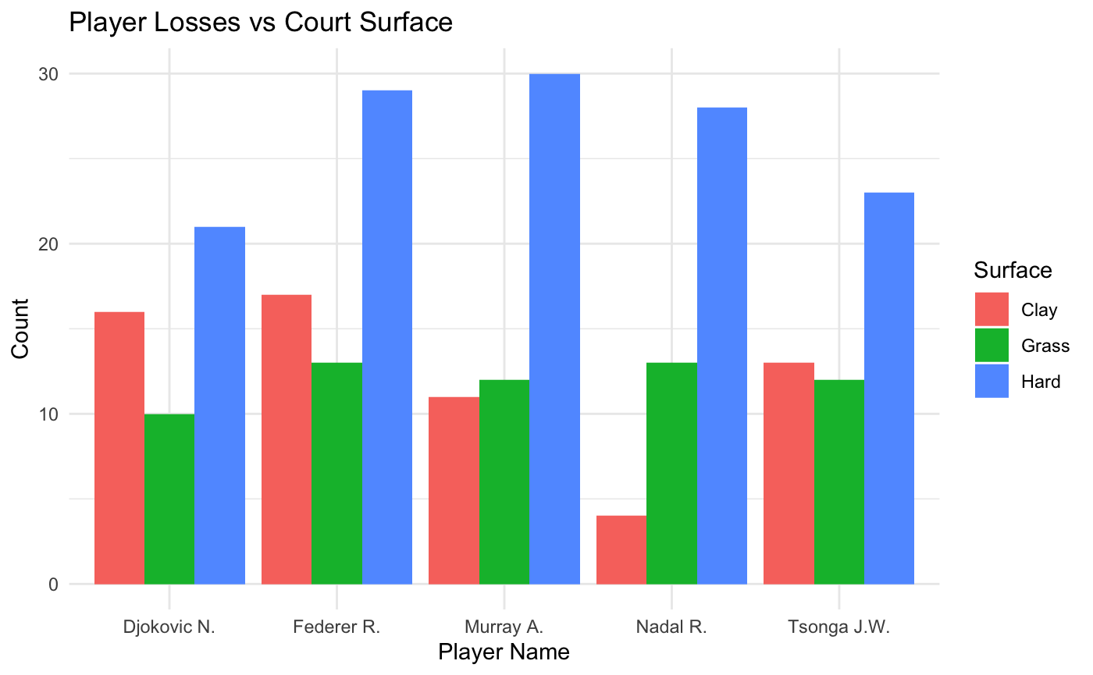
Data Analysis
atp_odds - Players vs. Courts
Notes:
atp_odds - ATP Match Odds
Observations:
1. All players seem to perform very well and also lost the most games on the Hard Court.
2. Federer is the best on Hard Court and Grass Court but Nadal is the King of the Clay Court.
3. Murray loses the most on Hard Court, followed by Federer and Nadal on the Grass Court and Federer on the Clay Court.
4. Overall, Federer wins more games as compared to Tsonga and Djokovic wins more games as compared to Nadal.
4. Overall, Tsongs loses more games as compared to Federer and Nadal loses more games as compared to Djokovic

Slide 6
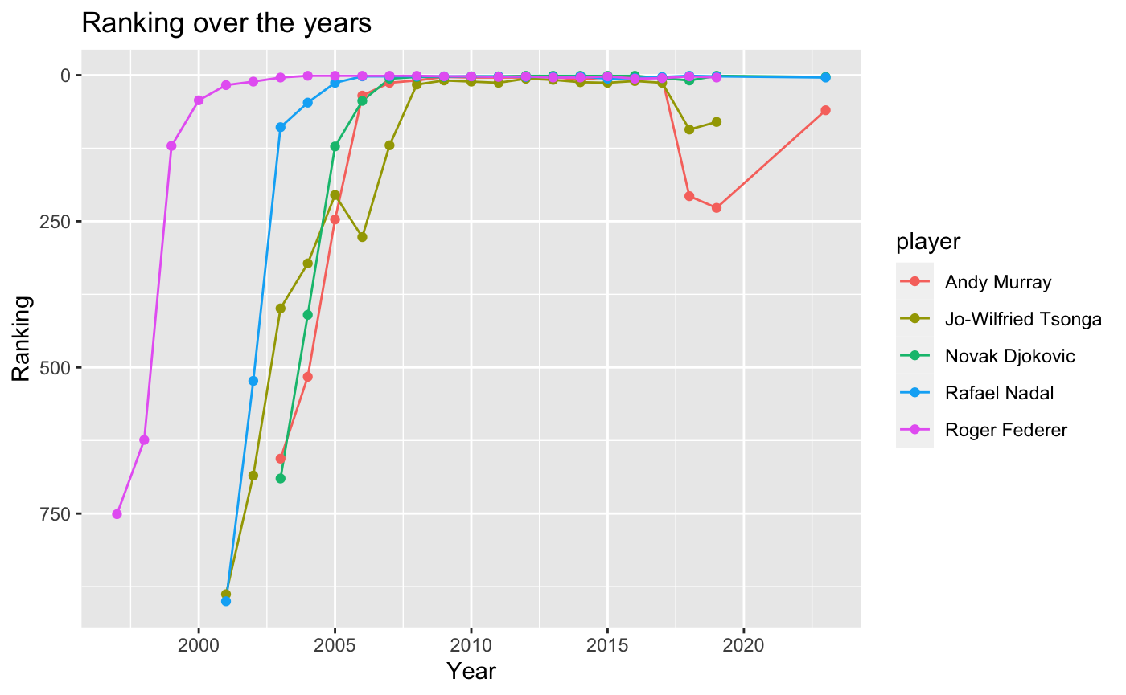
Data Analysis
atp_rankings - Seed over the Years
Notes:
Observations:
1. Jo-Wilfried Tsonga has the shortest history of ranking 1 with some minor downs along the way.
2. Rodger Federer would have had the longest first seed if he didnt retire in 2022
3. Rafael has held the first seed for 23 years now.
4. Tsonga's reign lasted about 8 years.

Slide 7
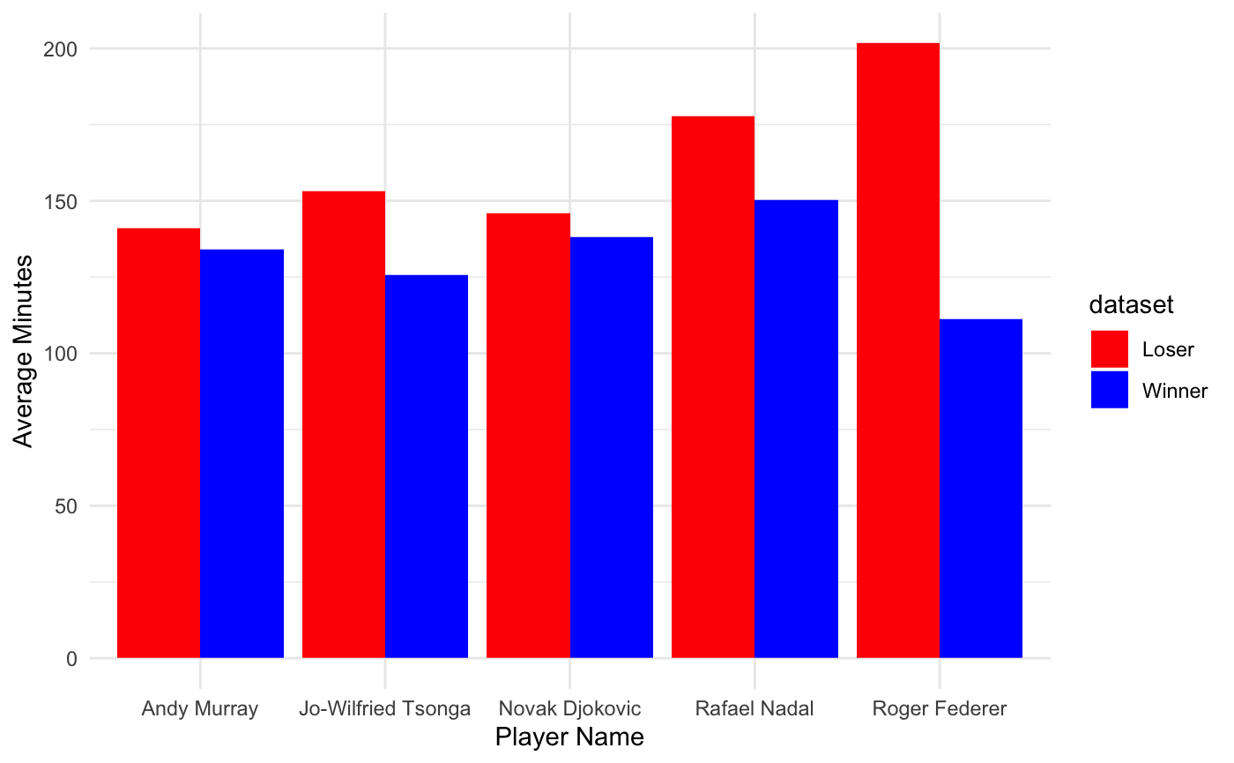
Data Analysis
atp_matches - Wins / Loses vs Time
Notes:
atp_matches - ATP Playing Activity
Observations:
1. Tennis matches last anywhere between 2 to 3 hours.
2. The longest tennis match lasted about 11 hours over a period of 3 days between John Isner and Nicolas Mahut in Wimbledon in 2010.
3. Rodger Federer spends the most time trying to salvage his game and ultimately losing but spends less time playing when he does win it.
4. Rafael Nadal spends the most time winning his game and a good chunk of time trying to salvage it.

Slide 8

THANKS!

